Slide 1
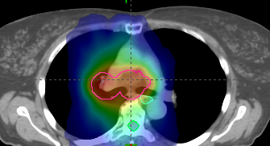
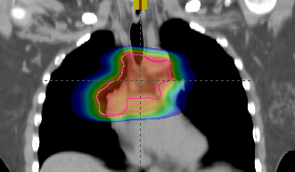
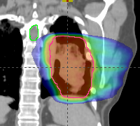
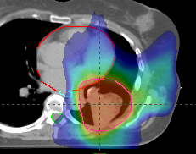
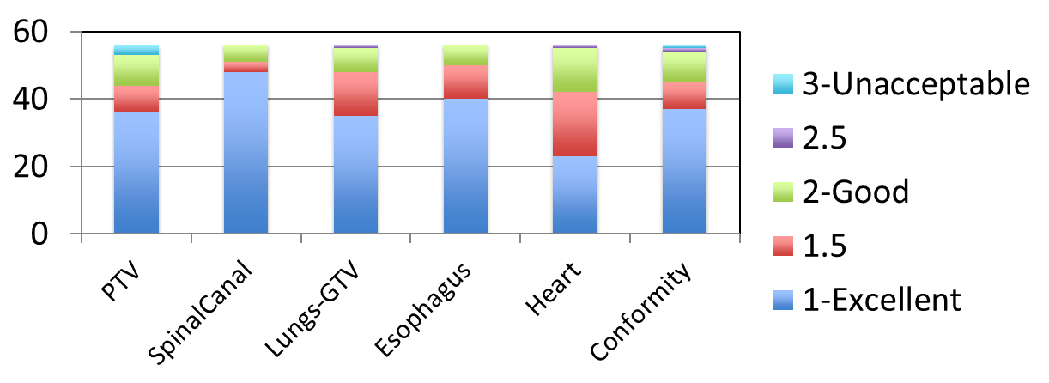
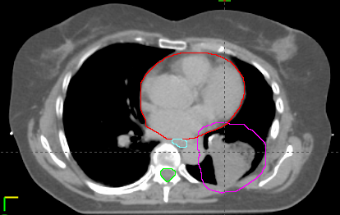
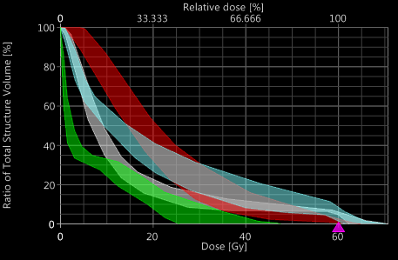
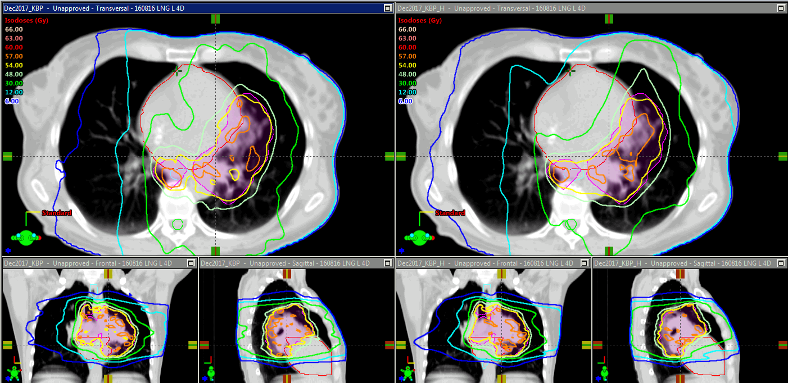
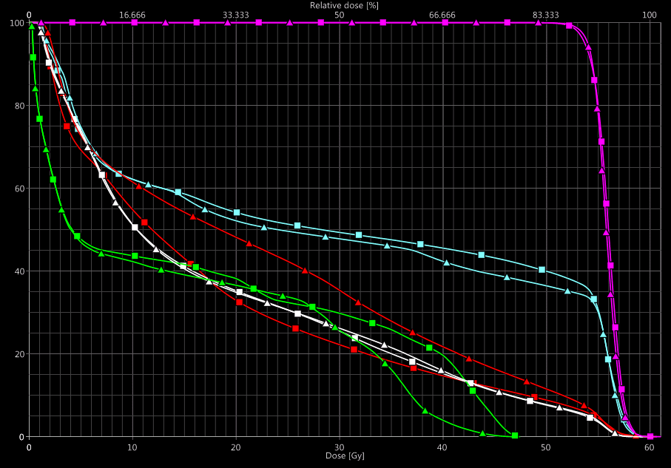
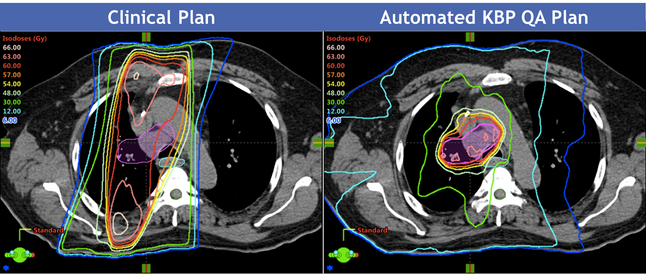
Knowledge Based Quality Assurance and Improvement in Locally Advanced Lung Cancer Radiotherapy in a Statewide Consortium of Academic and Community Practice Centers M. M. Matuszak¹, M. Grubb¹, R. Marsh¹, K. M. Masi², D. Lack³, D. A. Dryden⁴, M. Wilson⁵, D. Jarema¹, D. Tatro¹, E. P. Short⁶, T. J. Bichay⁷, J. M. Moran¹, C. Fraser⁸, K. Vineberg¹, P. A. Paximadis⁹, M. M. Dominello¹⁰,
J. D. Radawski¹¹, L. L. Kestin⁵, L. J. Pierce¹, S. Jolly¹, J. A. Hayman¹, T. P. Boike¹², and On behalf of the Michigan Radiation Oncology Quality Consortium
¹Michigan Medicine, Ann Arbor, MI, ²Karmanos Cancer Institute, Detroit, MI, ³Beaumont Health System, Troy, MI, ⁴McLaren Northern Michigan, Petoskey, MI, ⁵Michigan Healthcare Professionals, 21st Century Oncology, Farmington Hills, MI, ⁶Department of Radiation Oncology, Providence Cancer Center, Novi, MI, ⁷Saint Mary's Health Care, Ann Arbor, MI, ⁸Henry Ford Health System, Detroit, MI, ⁹Lakeland Radiation Oncology, St. Joseph, MI, ¹⁰Department of Oncology, Wayne State University School of Medicine, Detroit, MI, ¹¹West Michigan Cancer Center, Rockford, MI, ¹²Karmanos Cancer Network, Detroit, MI
PURPOSE / OBJECTIVES
RESULTS
QUICK SUMMARY / CONCLUSION
Treatment planning for locally advanced lung cancer is complex due to large PTVs and their close proximity to multiple organs at risk. Given the difficult tradeoff decisions encountered, it can be challenging to judge plan quality.
A statewide consortium of academic and community practices, the Michigan Radiation Oncology Quality Consortium (MROQC), collaborated to develop and validate a multi-institutional knowledge based planning (KBP) model of high quality lung plans for use as a quality assurance and improvement tool.
A multi-institutional locally advanced lung cancer radiotherapy KBP model was created using 43 team-scored cases and validated using 10 independent team-scored high quality cases.
In the 10 validation cases, there were no significant differences in any of the target or OAR metrics in the high quality manual clinical plans vs. automated KBP plans, demonstrating that the model was able to predict and confirm HQC plans.
In 32 randomly selected clinical plans, the KBP model identified potential improvements in PTV coverage (2.3 +/- 3.0 Gy average improvement in D95%) in 78% of cases.
In 41% of cases, the KBP model identified improvement for ≥ 5 OAR metrics.
For example, the average estimated KBP reduction in heart mean dose was 1.9 +/- 1.6 Gy.
In 25% of cases, KBP identified simultaneous improvement in PTV coverage and ≥ 5 OAR metrics, with 3DCRT cases more likely see an improvement vs. intensity modulated cases.
A multi-institutional locally advanced lung cancer knowledge based planning (KBP) model was created from plans collected by the Michigan Radiation Oncology Quality Consortium (MROQC), a statewide collaborative of community and academic practices.
The model was validated and confirmed to predict high quality plans as scored by a multidisciplinary team.
When using the model for QA in randomly selected clinical plans, 78% (25/32) and 41% (13/32) of cases were identified as having potential improvement in PTV coverage and ≥ 5 dosimetric OAR goals, respectively.
Work is ongoing to develop a vendor-neutral web-based interface to provide prospective patient-specific feedback on plan quality to consortium institutions.
MATERIALS & METHODS
Figure 1. Example of a clinical vs. automated KBP QA plan in which potential quality improvements were possible.
56 plans from 9 institutions w/ different planning systems and techniques collected for KBP database
Multi-disciplinary case scoring to select high quality clinical plans (HQC) for KBP model
Figure 2. Example of a potential future use of the KBP quality improvement where the model was adjusted to reduce dose to the heart, demonstrating minimal effects on other goals.
ACKNOWLEDGEMENTS
KBP Model
Model training with 43 cases and validation with 10 independent cases
Standard KBP Model
KBP+Reduced Heart Dose
The authors would like to thank the members of the Michigan Radiation Oncology Quality Consortium (MROQC) who have supported this work through their participation in the collaborative quality initiative.
MROQC is supported by Blue Cross Blue Shield of Michigan and the Blue Care Network as part of the BCBSM Value Partnerships program.
M. Matuszak has received grant funding in the area of KBP from Varian Medical Systems in the last 12 months
Original KBP: Triangles
KBP+Heart Sparing: Squares
PTV
32 randomly selected patients from 7 institutions planned with KBP for quality assurance/ improvement test
Esophagus
Lungs-GTV
Heart
Mean Heart Dose
22.4->17.8
SpinalCanal
Contact information:
Please email Martha M. Matuszak (marthamm@med.umich.edu) for questions or visit mroqc.org

